Slide 1
Design And Analysis of Algorithms Project UE17CS251

Slide 2
AVL TREES VISUALISATION AND USING IT TO STORE STUDENT INFORMATION
By
Abhishek Patil
Manthan B .Y

Slide 3
Aim of the Project
Implementing AVL trees
Visualization of AVL trees
Using AVL trees to store student information like Name,SRN,Age.

Slide 4
Features of the project
Visualisation
Insertion
Deletion
Preorder
Postorder
Inorder
Print Balance Factors

Slide 5
Designed using
Javascript
HTML
CSS
BootStrap

Slide 6
What are AVL trees?
AVL tree is a self-balancing Binary Search Tree (BST) where the difference between heights of left and right subtrees cannot be more than one for all nodes.

Slide 7
Why use AVL trees?
Most of the BST operations (e.g., search, max, min, insert, delete.. etc) take O(h) time where h is the height of the BST. The cost of these operations may become O(n) for a skewed Binary tree. If we make sure that height of the tree remains Logn after every insertion and deletion, then we can guarantee an upper bound of O(Logn) for all these operations. The height of an AVL tree is always Logn where n is the number of nodes in the tree.

Slide 8
AVL Trees Insertion(1)
To make sure that the given tree remains AVL after every insertion, we must augment the standard BST insert operation to perform some re-balancing. Following are two basic operations that can be performed to re-balance a BST without violating the BST property (keys(left) < key(root) < keys(right)). 1) Left Rotation 2) Right Rotation Steps to follow for insertion Let the newly inserted node be w 1) Perform standard BST insert for w.

Slide 9
AVL Trees Insertion(2)
2) Starting from w, travel up and find the first unbalanced node. Let z be the first unbalanced node, y be the child of z that comes on the path from w to z and x be the grandchild of z that comes on the path from w to z. 3) Re-balance the tree by performing appropriate rotations on the subtree rooted with z. There can be 4 possible cases that needs to be handled as x, y and z can be arranged in 4 ways. Following are the possible 4 arrangements: a) y is left child of z and x is left child of y (Left Left Case) b) y is left child of z and x is right child of y (Left Right Case)

Slide 10
AVL Trees Insertion(3)
c) y is right child of z and x is right child of y (Right Right Case) d) y is right child of z and x is left child of y (Right Left Case) Following are the operations to be performed in above mentioned 4 cases. In all of the cases, we only need to re-balance the subtree rooted with z and the complete tree becomes balanced as the height of subtree (After appropriate rotations) rooted with z becomes same as it was before insertion

Slide 11
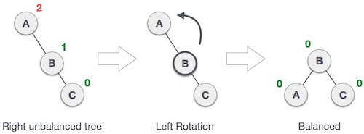
Right Right Case

Slide 12
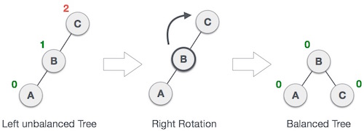
Left Left Case

Slide 13
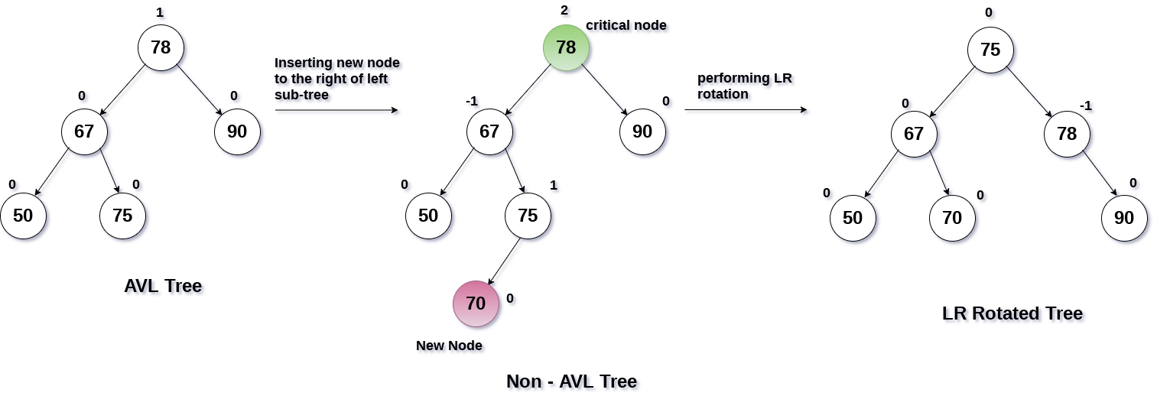
Left Right Case

Slide 14
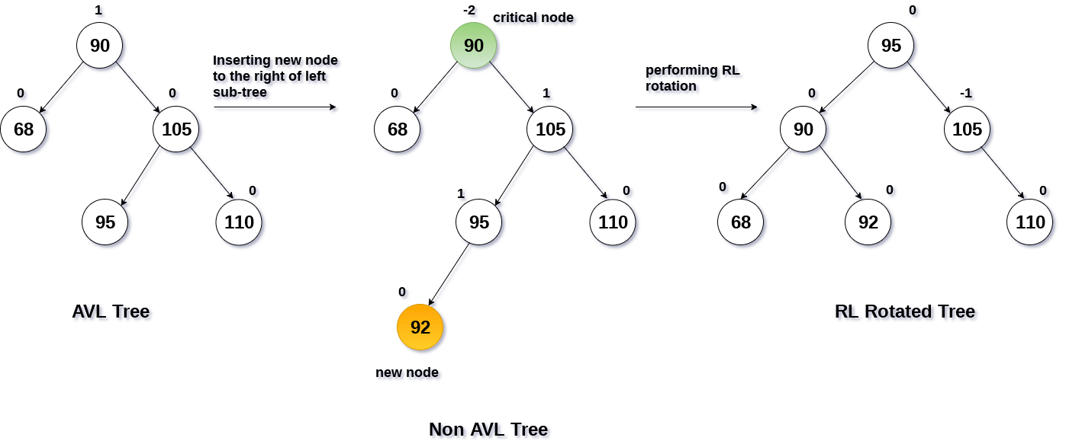
Right Left Case

Slide 15
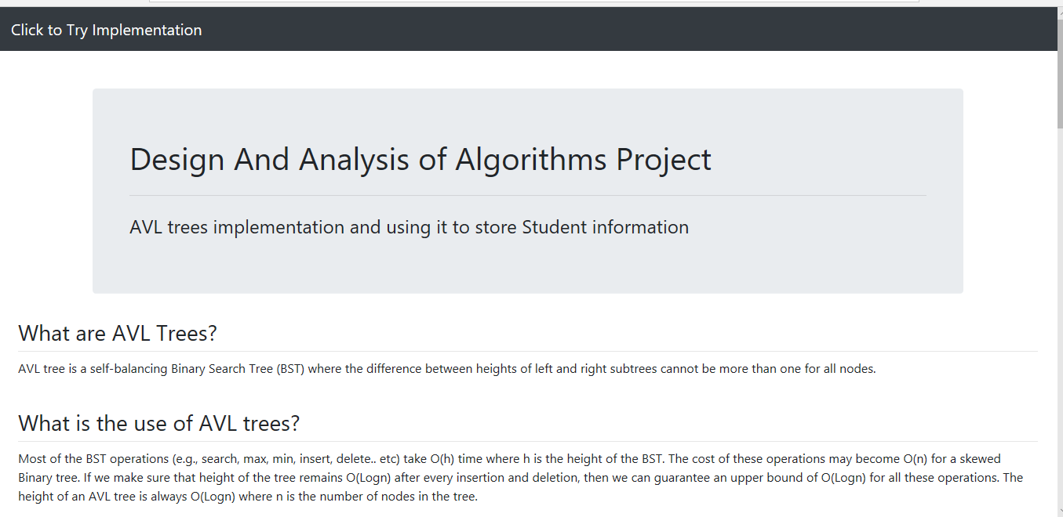
Visualisation of AVL Trees

Slide 16
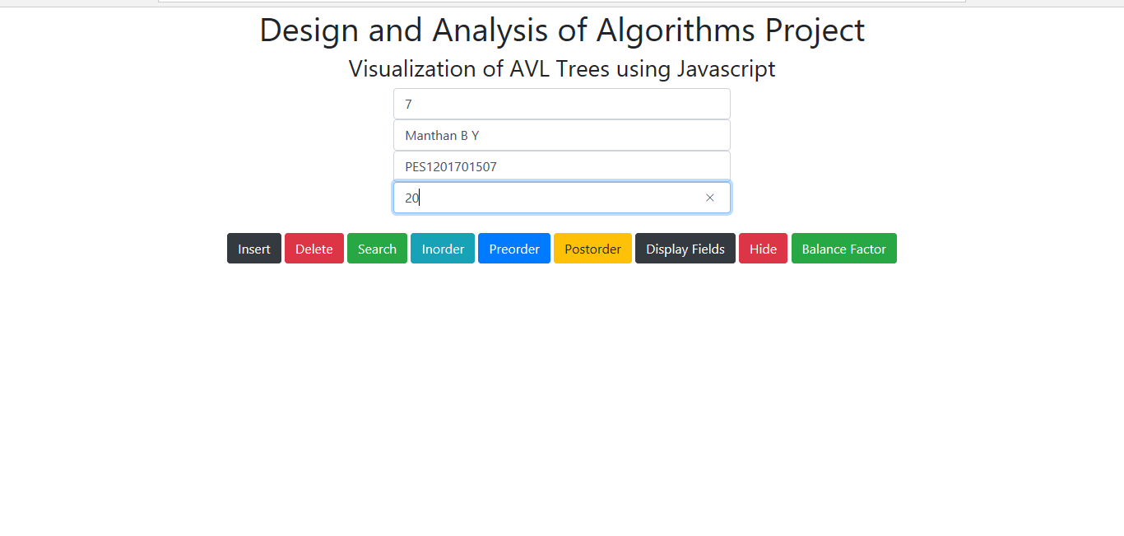
Visualisation Of AVL Trees

Slide 17
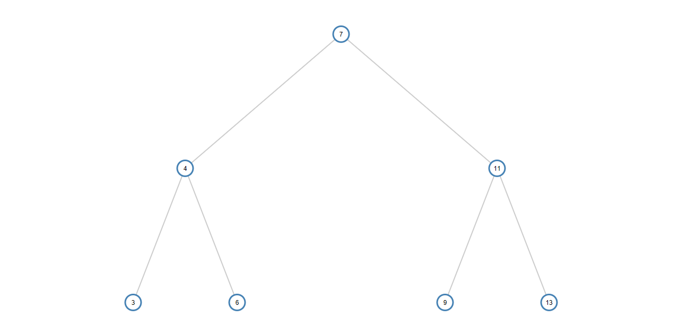
Visualisation Of AVL Trees

Slide 18
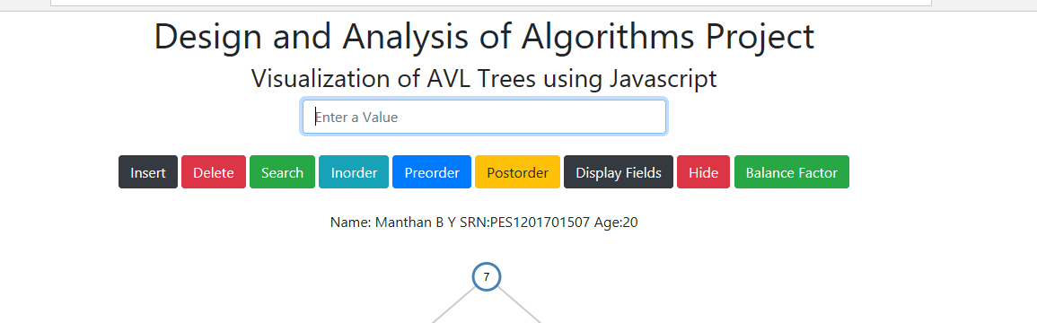
Visualisation of AVL Trees

Slide 19
Click on the link to try
front.html

Slide 20
Design Technique
Javascript is used to implement the AVL trees and the visualisation part
HTML ,CSS ,BootStrap is used to design the front end

Slide 21
References
GeeksForGeeks
JavaTutorialsPoint
Wikipedia
Google
BootStrap Official website

Slide 22
Thank You

